Slide 1

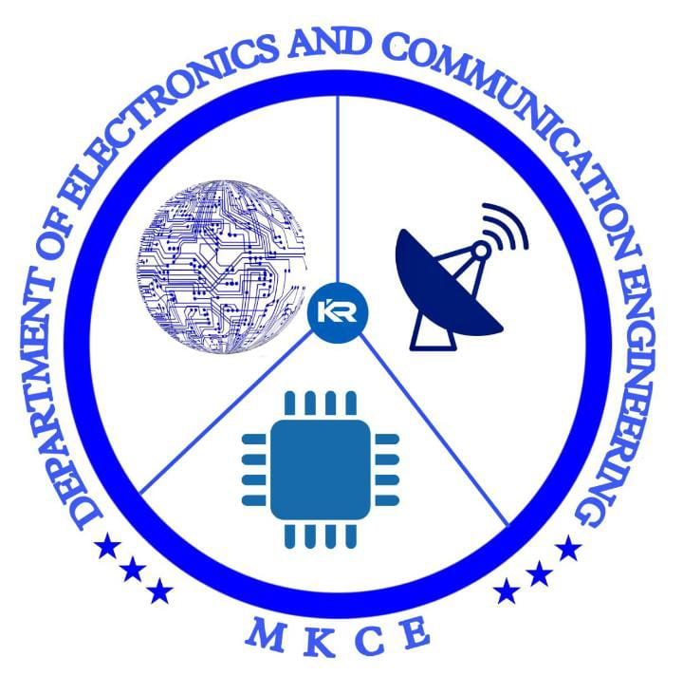

DETECTION OF BREATH COUNT USING BIOSENSOR
BY:
SANCHANA SRI S

Slide 2
INTRODUCTION
There are several ways we can monitor the respiratory system in the human body. Some authors used specialized sensors that monitor breathing movements.
IoT-assisted wearable sensor systems technology is a booming and blooming field in healthcare. As the healthcare sector expands, we need a doorstep diagnosis, easily monitoring and controlling the data.
This can help us make discoveries regarding healthcare, medicine, drugs, and vaccines. The end goal of this is to make the data secure and accessible by the right people via cloud computing, fog computing, etc.

Slide 3
OBJECTIVE
To Detect the Breath Counting using Biosensor for Healthcare Monitoring.

Slide 4
RESPIRATORY RATE
The average adult’s respiration rate to heart rate is approximately 1:4, which means that for each breath, the heart beats 4 times.
Normal respiration rates for an adult person at rest range from 12 to 16 breaths per minute.
Your respiratory rate is also known as your breathing rate. This is the number of breaths you take per minute.
There is a direct positive relationship between respiration rate (number of breaths) and heart rate. The more the heart beats, the more breathing occurs. As the heart beats faster, it uses more energy and sends more oxygen to the body.

Slide 5
POWER
SUPPLY
HEART BEAT
SENSOR
ARDUINO
UNO
BLUETOOTH MODULE
BLUETOOTH
MODULE

Slide 6
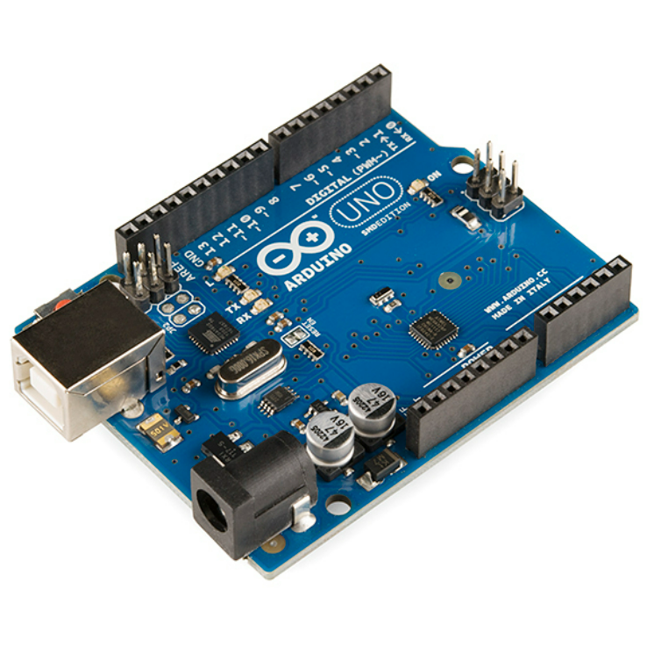
COMPONENTS REQUIERED
Arduino UNO Board
Pulse Sensor
Jumper Wire
Bluetooth Module

Slide 7
PULSE SENSOR
A pulse wave is the change in the volume of a blood vessel that occurs when the heart pumps blood, and a detector that monitors this volume change is called a pulse sensor.
The heart normally beats 60 to 70 times per minute, while the breathing rate is about one-fifth of that.
The range of output from the Pulse Sensor running at 3.3V is only 0 to 675.

Slide 8
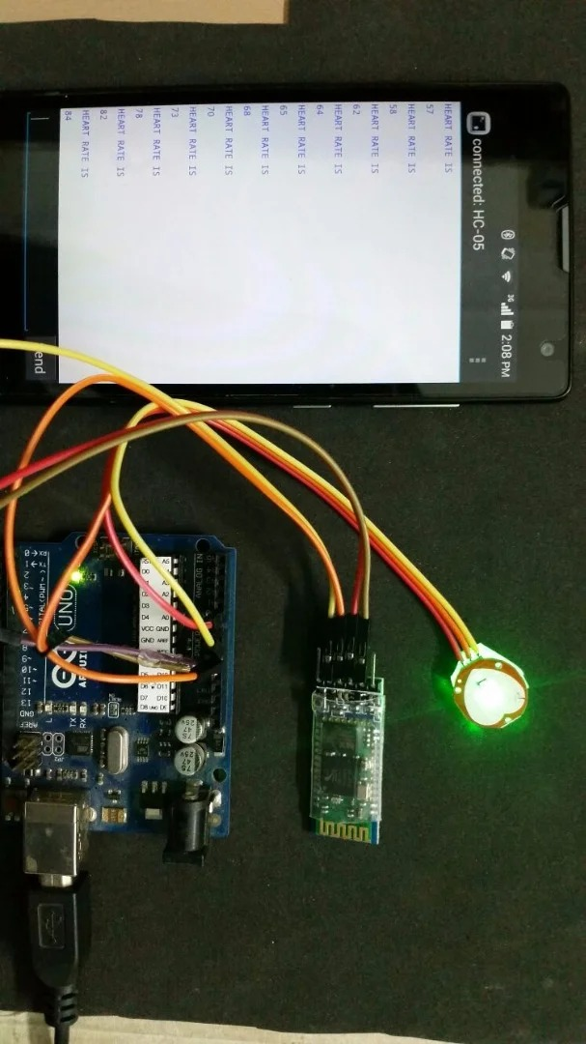

Slide 9
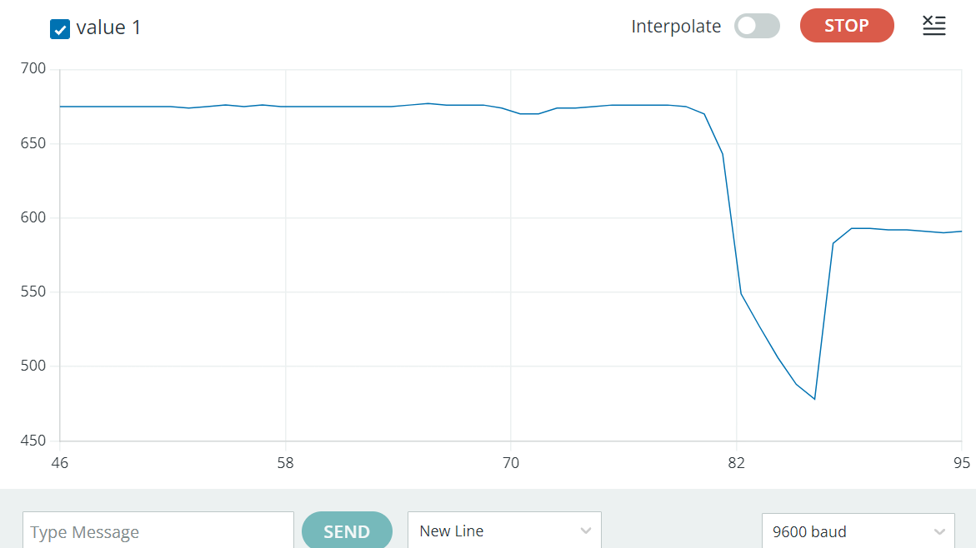

Slide 10
WORKING PRINCIPLE
The basic heartbeat sensor consists of a light-emitting diode and a detector like a light detecting resistor or a photodiode. The heartbeat pulses cause a variation in the flow of blood to different regions of the body. When tissue is illuminated with the light source, i.e. light emitted by the led, it either reflects (a finger tissue) or transmits the light (earlobe). Some of the light is absorbed by the blood and the transmitted or the reflected light is received by the light detector. The amount of light absorbed depends on the blood volume in that tissue. The detector output is in the form of the electrical signal and is proportional to the heartbeat rate.

Slide 11
APPLICATIONS
Fitness Tracking,
Medical Monitoring,
Stress Detection,
Sleep Tracking,
Gaming.

Slide 12
CONCLUSION
This project can have a range of applications, from personal health monitoring to medical research and sports training.
Overall, the pulse sensor, Arduino and Bluetooth module project is a great example of how technology can be used to improve health monitoring and enhance our understanding of the human body. With some basic electronics knowledge and programming skills, anyone can build a custom heart rate monitor that meets their specific needs and goals.

Slide 13
REFERENCE
[1].Godi, B.; Viswanadham,S.Muttipati, A.S.Samantray, O.P.;Gadiraju, S.R. E-Healthcare Monitoring System using IOT with Machine Learning Approaches. In Proceedings of the 2020 International Conference on Computer Science, Engineering and Applications (ICCSEA).
[2]. Raj, C.; Jain, C.; Arif, W. HEMAN: Health monitoring and nous: An IoT based e-health care system for remote telemedicine. In Proceedings of the 2017 International Conference on Wireless Communications, Signal Processing and Networking (WiSPNET), Chennai.
[3]. Zaman, F.; Lee, S.; Rahim, M.K.A.; Khan, S. Smart Antennas and Intelligent Sensors Based Systems: Enabling Technologies and Applications. Wirel. Commun. Mob. Comput.

Slide 14



